Slide 1


The Role of Research Leaders on the Evolution of Scientific Communities
Bruno Leite Alves
Fabrício Benevenuto Alberto H. F. Laender
Federal University of Minas Gerais
Belo Horizonte, Brazil
Notes:
My name is Bruno Leite Alves and I will talk about the role of research leaders on the evolution of scientific communities.
This work was done with Fabrício Benevenuto and Alberto Laender.
We are from Federal University of Minas Gerais, from Belo Horizonte, Brazil.

Slide 2
Society is Organized in Communities
There are a lot of kinds of communities
In a social networks, individuals influence and are influenced by others
Communities have opinion leaders
A group of leaders or influential members are able
to affect the dynamics of the entire community
Notes:
The society is organized in communities and there are a lot of kinds of communities, such as: fans of a sport, fans of a celebrity, friend’s communities, and scientific communities and so on.
We may name these communities as social networks, and inside of these social networks there are individuals who influence and are influenced by others.
There are a lot of works which point that these communities have leaders and these leaders are able to affect the opinion of other people. In this way, groups of leaders or influential are able to affect the dynamics of the entire communities.

Slide 3
Our Goal
Study the dynamics of scientific communities
Identify leaderships within scientific communities (Community Core)
Investigate the properties of a Community Core
Notes:
Here, we want to identify leaders inside of scientific communities.
In this way, our goal is to study the dynamics of scientific communities and identify leaderships in these communities, here we named community core.
We are also interested in the properties of the community core.

Slide 4
Core Score
Estimates a researcher’s importance within a community.
The core score of a researcher r into a community c in a period of time t is given by:
CoreScore_{r,c,t} = h_{r} × #publications_{r,c,t}
Notes:
In this context, which we would like to identify the most important members, we needed to quantify the importance of the researchers inside of communities.
So we defined this metric: Core Score. The core score estimates a researcher’s importance within a community and the core score of a researcher r into a community c in a specific time t is given by h-index of a researcher times the number of publications of a researcher into a community in a period of time.
An important piece of this metric is the h-index, so we needed to obtain this value.
H = h-index
R = research
C = conference (community)
T = Time
- A importantece piece to define the core score is h-index

Slide 5
Important Steps
We used 24 conferences extracted of DBLP
We estimated the H-Index using Shine project
We defined two thresholds:
Community core size: 10%
Temporal Sliding Window Size: 3 years
Notes:
So, our first attempt (try) it was to use the Google Scholar, an important tool which is widely used among scientific communities to calculate the h-index.
For it, we randomly selected 10 researchers for each conference, but only 30% of DBLP authors had a profile at Google Scholar.

Slide 6
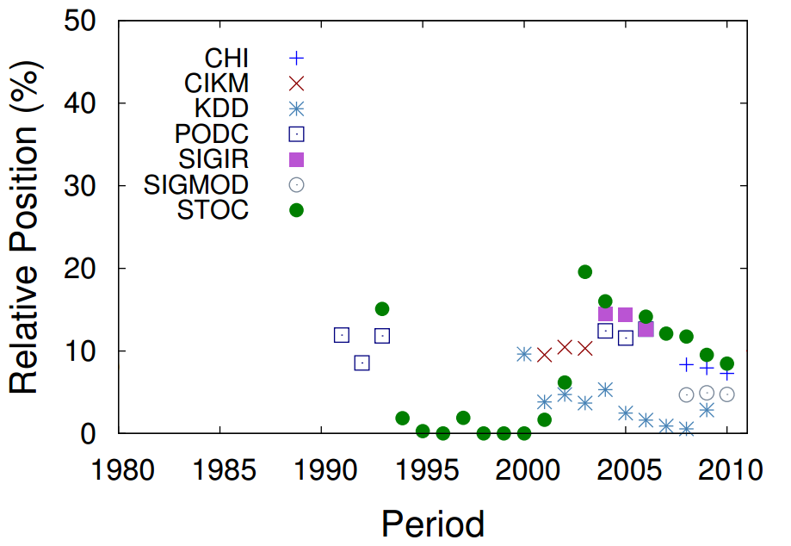
Jon Kleinberg’s Communities
Community Core
Three years window
Moving from STOC to KDD
Notes:
It is possible note Jon Kleinberg moving from STOC to KDD and other conferences.
CHI - Conference on Human Factors in Computing Systems
CIKM - Conference on Information and Knowledge Management
KDD – Knowledge, Discovery, and Data Mining
PODC - Symposium on Principles of Distributed Computing
SIGIR – Special Interest Group on Information Retrieval
SIGMOD – Special Interest Group on Management of Data
STOC – Symposium on Theory of Computing

Slide 7
Awarded Researchers
Members of the core community awarded
Notes:
A second validate we proposed is to identify conference which was awarded as the best researcher and observe whether these researchers were members of the community core.
It is possible to observe a high number of members of community core awarded in SIGMOD, KDD and SIGIR.
In SIGCOMM case, several researchers appeared in SIGCOMM sponsors conference.
SIGMOD - Management of Data
SIGKDD - Knowledge Discovery in Data
SIGIR - Information Retrieval
SIGCOMM - Data Communication

Slide 8
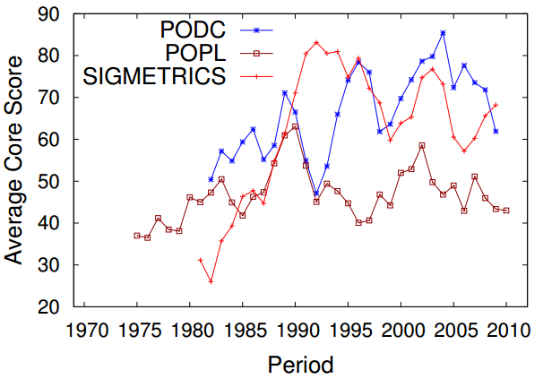
Influence of Core Members
Three years window
How does it affect the network?
Notes:
Here is possible observe a similar behavior, but How does it affect the network?
PODC - Symposium on Principles of Distributed Computing
POPL - Symposium on Principles of Programming Languages
SIGMETRICS - Measurement and Evaluation

Slide 9
Strong Correlation with Average Core Score
Average Degree
0.59
Large WCC
0.5
Average Short Path
0.49
Diameter
0.49
-0.11
Clustering Coefficient
-0.56
Assortativity
Notes:
In this way, we calculated the correlation between the average core score and other complex networks metrics.
Except for clustering coefficient, every metric has a strong correlation with average core score, in other words, if we increase or decrease the average core score, these metrics also change.

Slide 10
Conclusions
The core community:
is strongly correlated with variations on network properties
works as bridges that connect groups
increases the average degree
decreases the assortativeness
Notes:
Well, with this work, we conclude that:
The core community work as bridges that connect smaller clustered research groups, and finally, the core community tends to increase the average degree of the network and decrease the assortativeness.

Slide 11
Conclusions
Future Work:
Analysis of other kinds of network such as massive multiplayer games and on-line social networks
Estimation of the h-index as a function of time
Notes:
As future work we propose to make analysis of other kinds of network such as massive multiplayer games and on-line social networks, and to estimate the h-index as a function of time.

Slide 12
Thank you!
Bruno Leite Alves Fabrício Benevenuto Alberto H. F. Laender
Computer Science Department
Federal University of Minas Gerais
{bruno.leite,fabricio,laender@dcc.ufmg.br}
Notes:
Thank you very much!

